Slide 1
Digital Portfolio
STUDENT NAME: A.ARIVU
REGISTER NO:24134121802521006
NM ID:autanm41241224ucsc001
DEPARTMENT: B.sc COMPUTER SCIENCE
COLLEGE: KALAIMAHAL ARTS AND SCIENCE
UNIVERSITY: ANNAMALAI

Slide 2
PROJECT TITLE
DIGITAL PORTFOLIO:
A Journey of Creativity and Growth
Showcasing Skills, Passion, and Dedication
My Work, My Identity, My Portfolio
From Ideas to Impact: A Digital Showcase
Exploring Innovation Through My Work

Slide 3
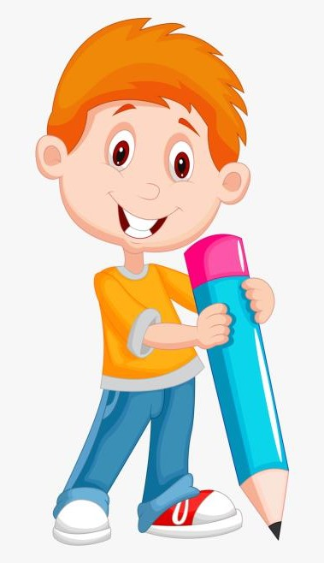

AGENDA
Problem Statement
Project Overview
End Users
Tools and Technologies
Portfolio design and Layout
Features and Functionality
Results and Screenshots
Conclusion
Github Link
3/21/2024 Annual Review

Slide 4

PROBLEM STATEMENT
A digital portfolio will provide an easy and modern way for students and professionals to showcase their skills, projects, and achievements. It can be updated anytime, shared easily, and accessed from anywhere. This makes it more effective than traditional CVs or paper portfolios, helping users present themselves better to schools, companies, or clients.

Slide 5
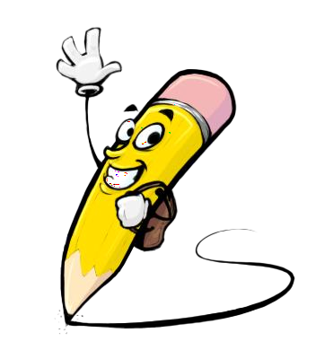
PROJECT OVERVIEW
“This project is about building my own portfolio website to showcase my skills, projects, and achievements. It acts like my personal space on the internet, where recruiters and clients can easily see what I do, check my projects, and contact me. The site will be simple, modern, and fully responsive.”

Slide 6

WHO ARE THE END USERS?
1.A clear reflection of my work and creativity.
2.Looking forward to your feedback and opportunities!

Slide 7

TOOLS AND TECHNIQUES
HTML5 – For structuring the web pages
CSS3 – For styling and responsive design
JavaScript (ES6+) – For interactivity and dynamic features
Codepen – As the code editor
Git & GitHub – For version control and hosting

Slide 8
POTFOLIO DESIGN AND LAYOUT
Proper visual hierarchy with headings and subheadings
Responsive layout for all devices (desktop, tablet, mobile)
Consistent color scheme throughout the portfolio
Use of high-quality images and project previews
Well-organized sections (About, Skills, Projects, Conta
8

Slide 9
FEATURES AND FUNCTIONALITY
Typing Animation – Hero section la text auto type aagum (Web Developer | Designer | Coder etc.).
Glassmorphism UI – Projects & skills cards semi-transparent glass effect + hover glow.
Scroll Reveal – Sections scroll panna fade-in animation varum.
Smooth Scrolling – Navbar links click panna smooth scroll effect.
Responsive Design – Mobile, tablet, desktop ellam ku adapt aagum

Slide 10
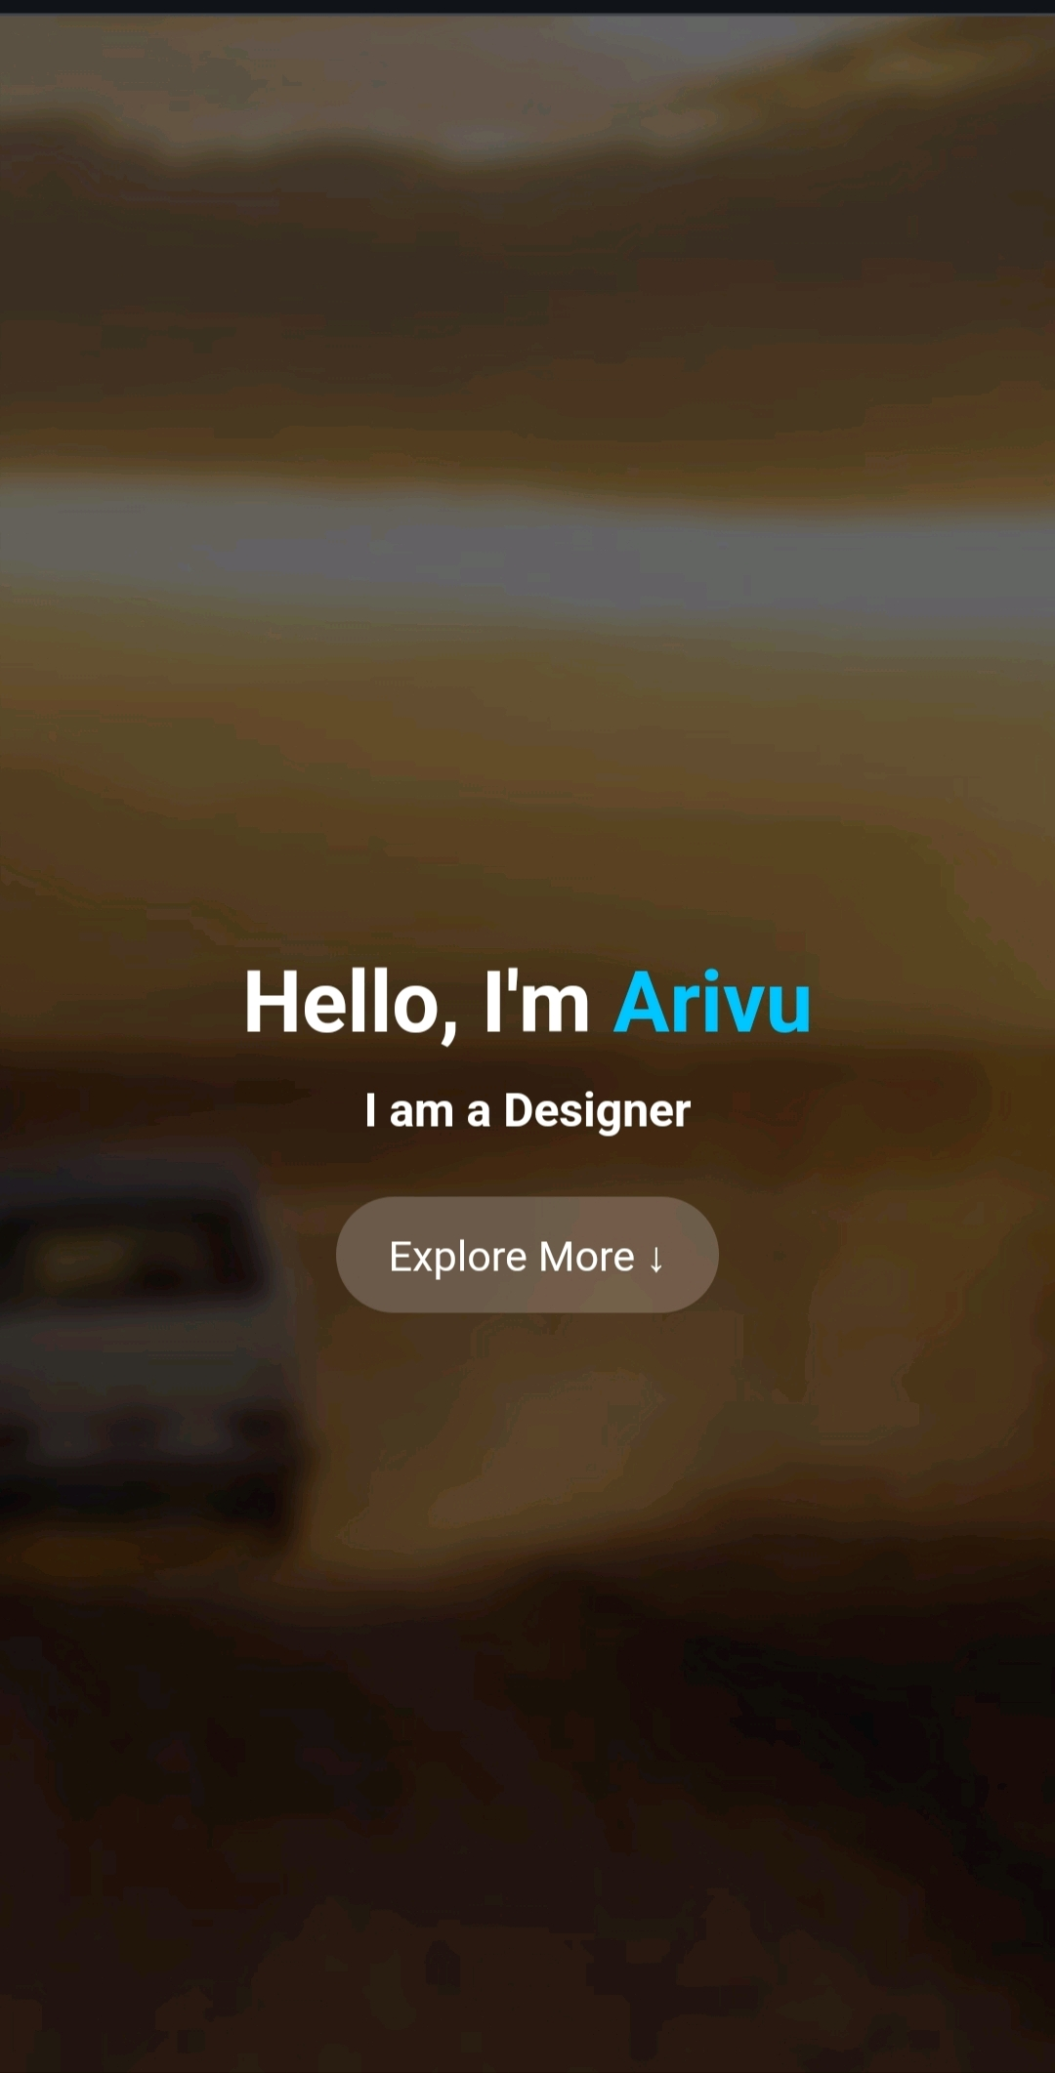

RESULTS AND SCREENSHOTS
3/21/2024 Annual Review
10

Slide 11
CONCLUSION
1. Modern portfolio with glassmorphism UI. 2. Includes typing, scroll, and hover animations. 3. Fully responsive for all devices. 4. Showcases About, Projects, Skills, Contact. 5. Interactive and user-friendly design.
11

